Slide 1
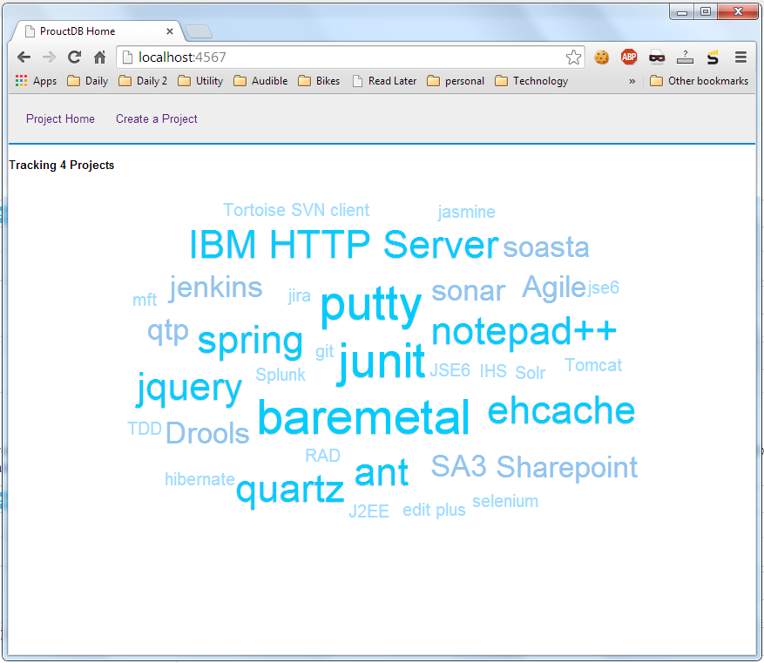
Home Page
More prominent header.
Bigger font
White on Black
Sapient colors ?
Tracking 4 projects
Needs to be bigger / bolder
Left gutter
Right gutter
Tag Cloud
Any better tag cloud library
Footer
Provision a footer

Slide 2
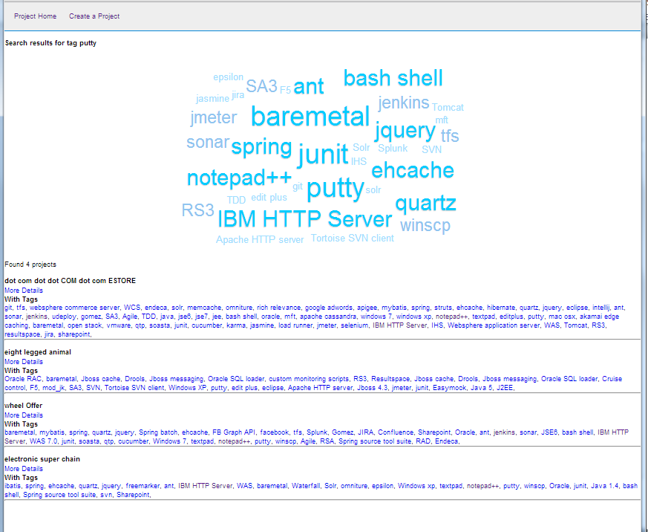
Tag Search Page
Search results for <tag> &
Found 4 projects
Needs to be bigger / bolder
Left gutter
Right gutter
Search results
Perhaps a 2 column layout
Project name on left and
tags on right

Slide 3
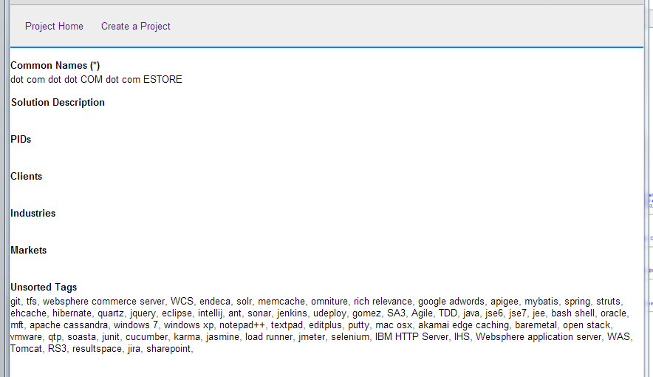
Project Details Page
Similar UI treatments
Can elements and data be at the same level

Slide 4
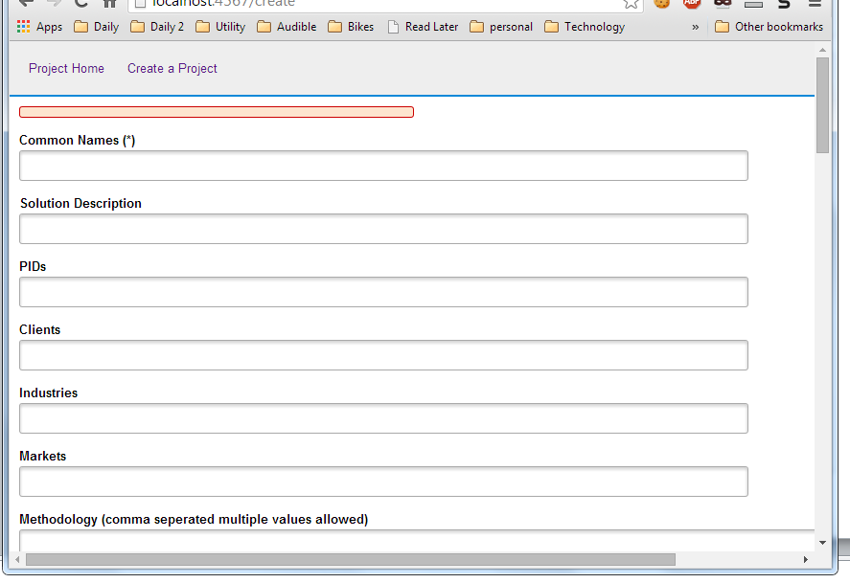
Create Project Page
Similar UI treatments
Can elements and data be at the same level
More prominent data field labels
Any framework for entering tags http://xoxco.com/projects/code/tagsinput/ or http://welldonethings.com/tags/manager shared between some fields

